Slide 1
COP2073
Introduction to Data Science Final Project
Madison Yonash

Slide 2
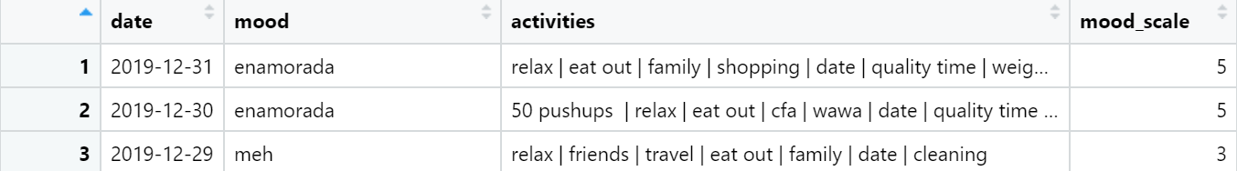
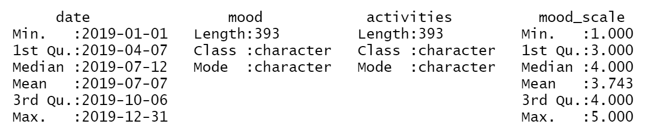
DATASET
Dailyo Mood Scale
Date, Mood, Activities, Mood Scale

Slide 3
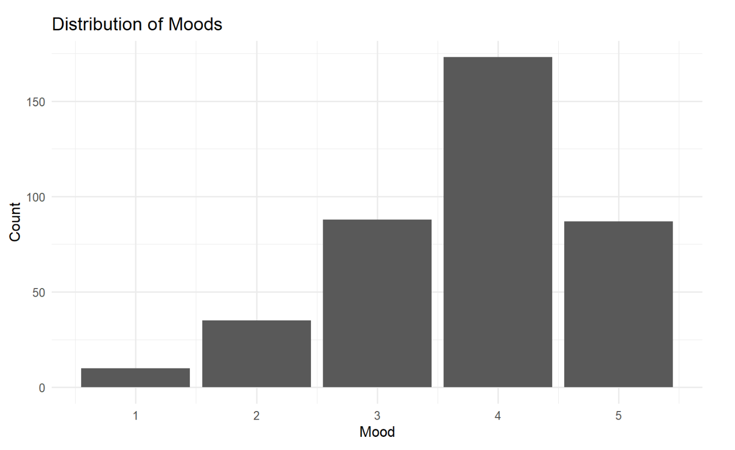
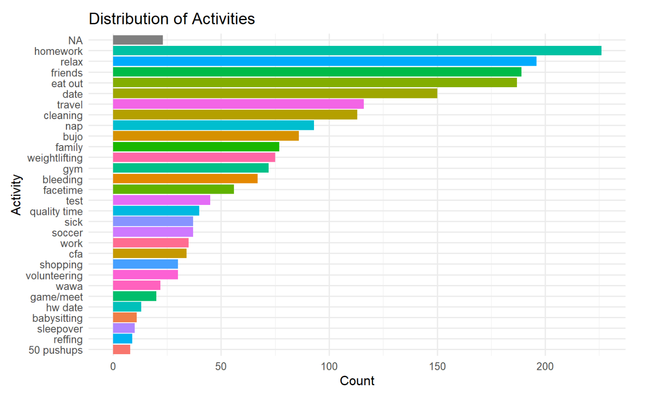
Univariate Data

Slide 4
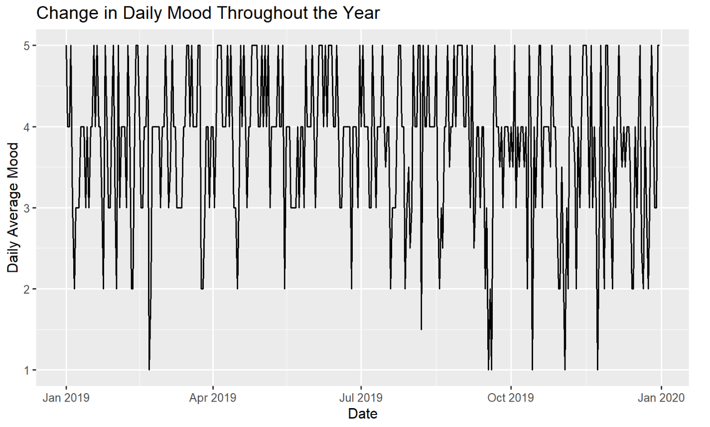
Multivariate Data

Slide 5
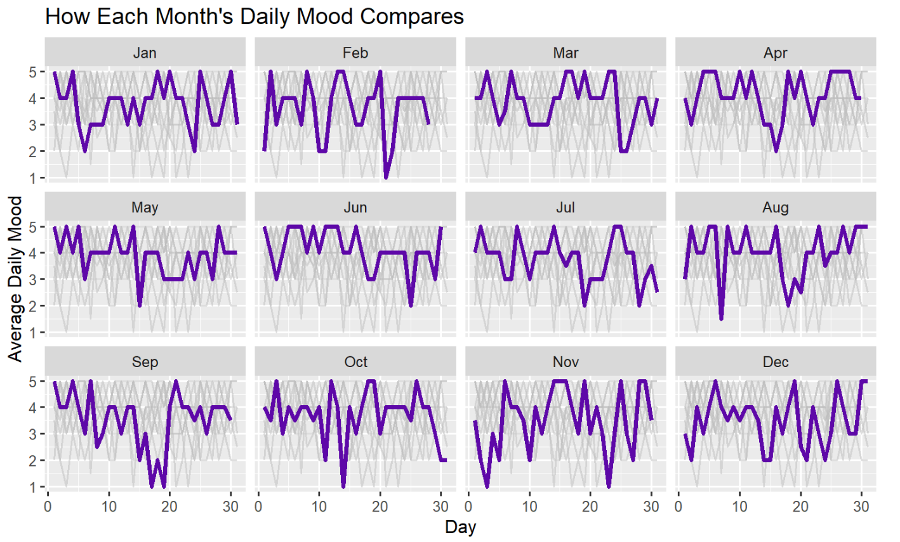
Multivariate Data

Slide 6
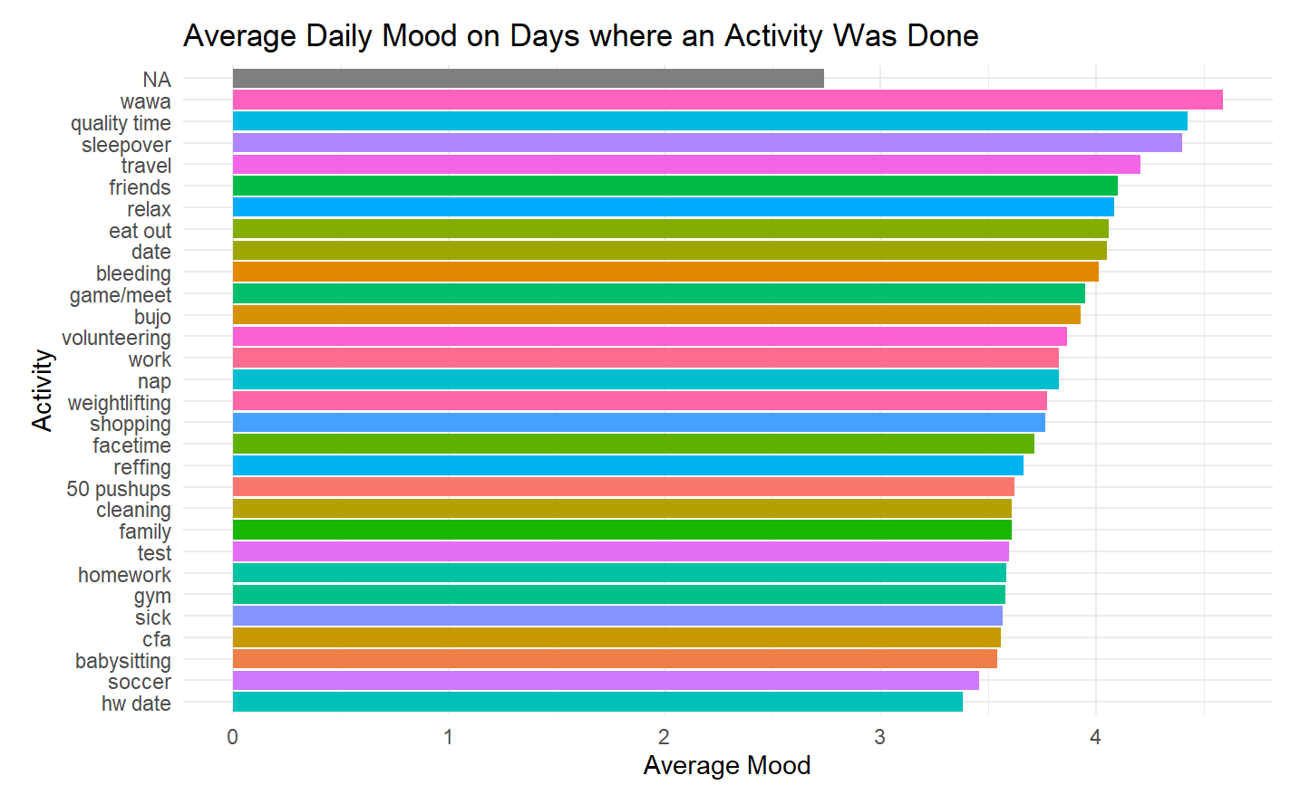
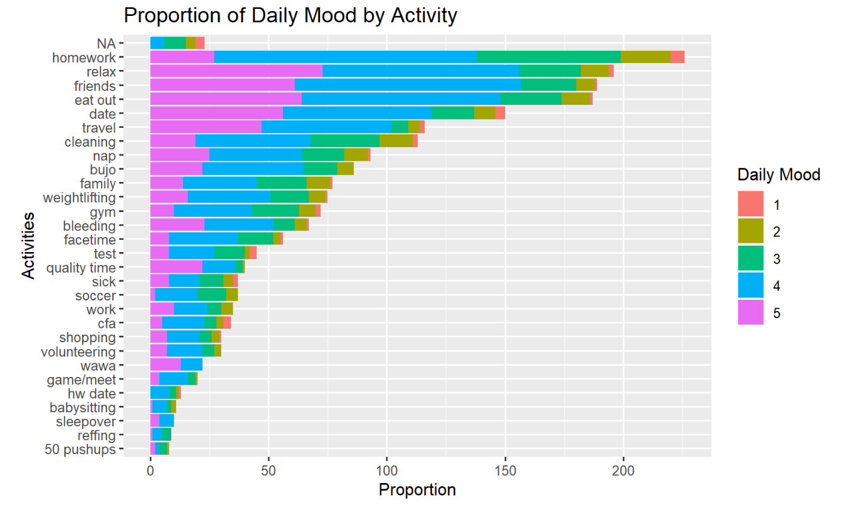
Multivariate Data

Slide 7
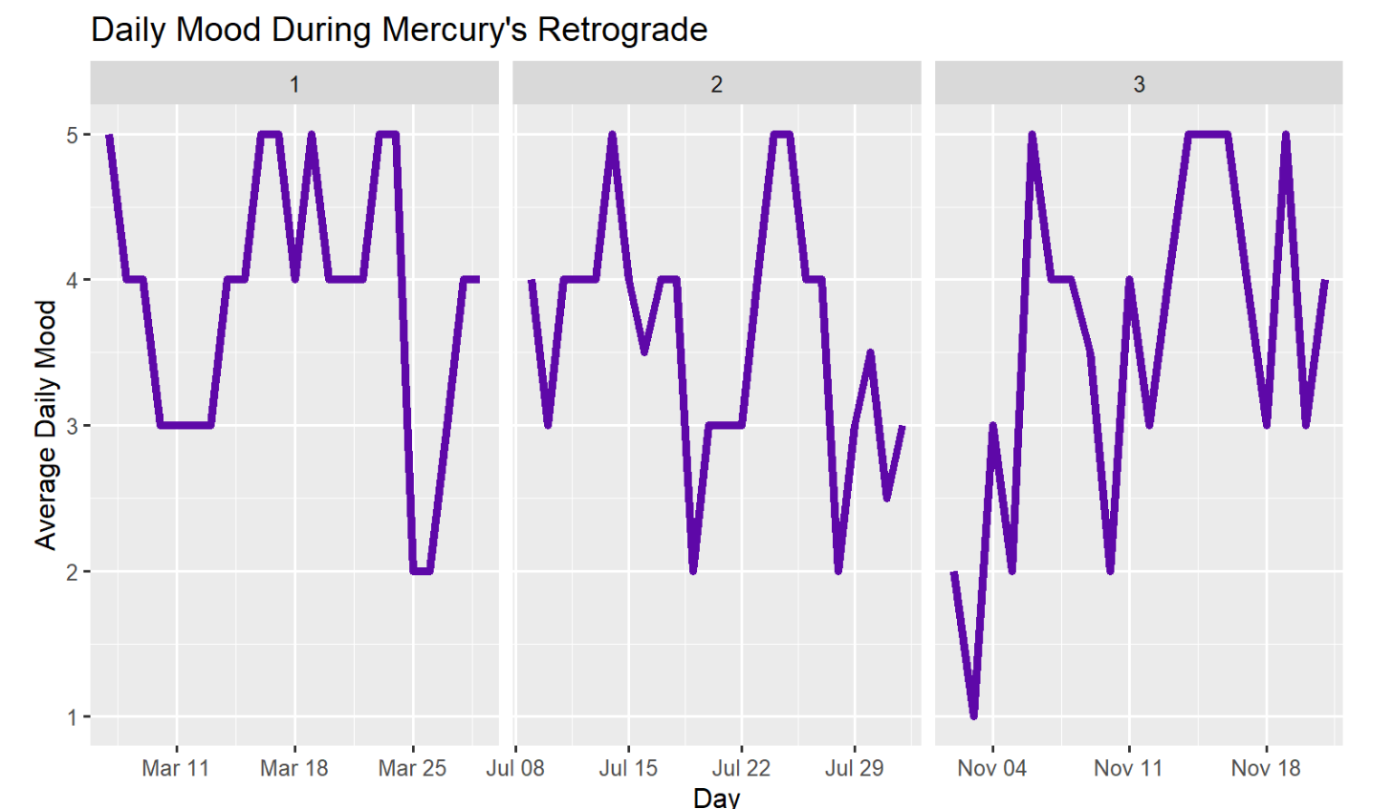
How was my mood during mercury retrograde?

Slide 8
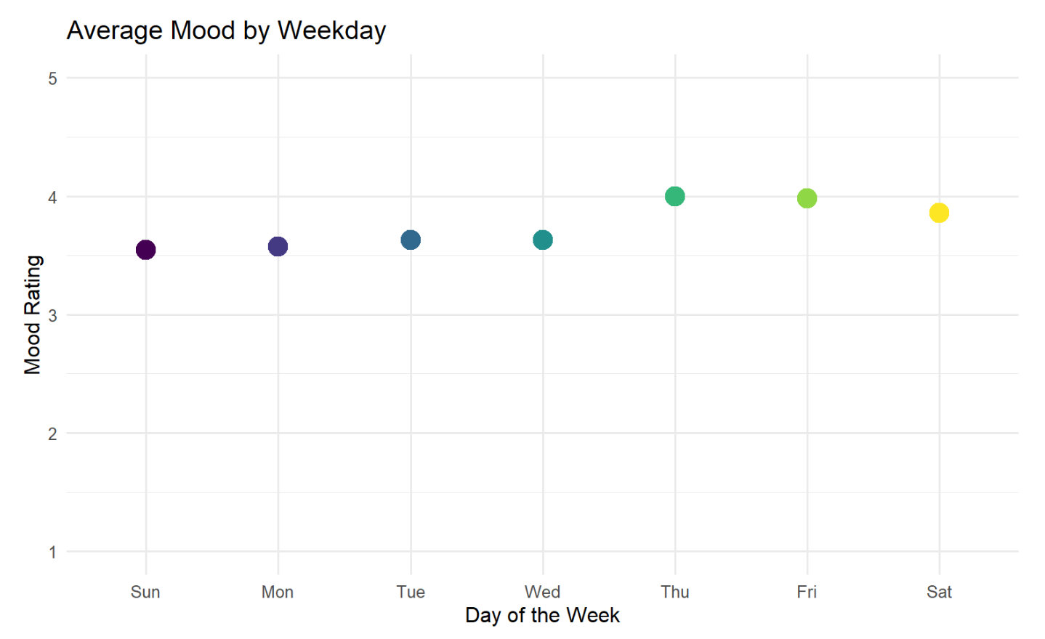
How did my mood tend to change on a day-to-day basis?

Slide 9
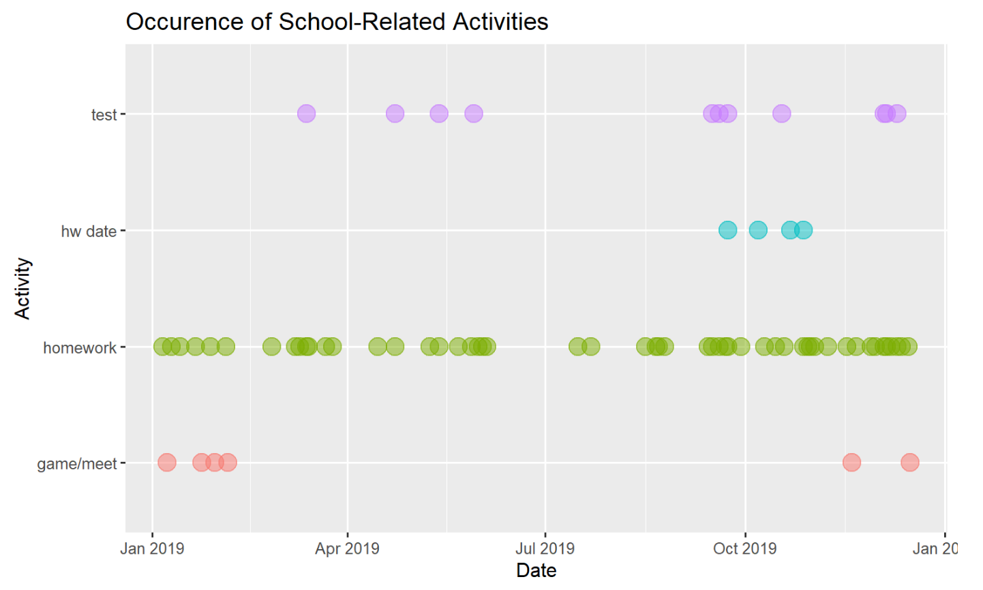
Does the school year affect the frequency of activities performed?

